Slide 1

Network Layer: IP Addressing
Lecture 6 | CSE421 – Computer Networks
Department of Computer Science and Engineering School of Data & Science

Slide 2
Objectives
IPv4 Address
Structure
Subnet/Prefix Mask
Types of IPv4 Address
IPv6 Address
Structure

Slide 3
Anatomy of IPv4

Slide 4
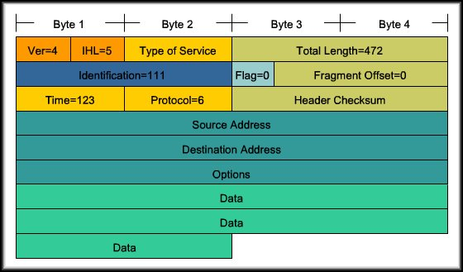
Anatomy of an IPv4 Address
Each device on a network must be uniquely identified at the Network layer.
For IPv4, a 32 bit source and destination address is contained in each packet.

Slide 5
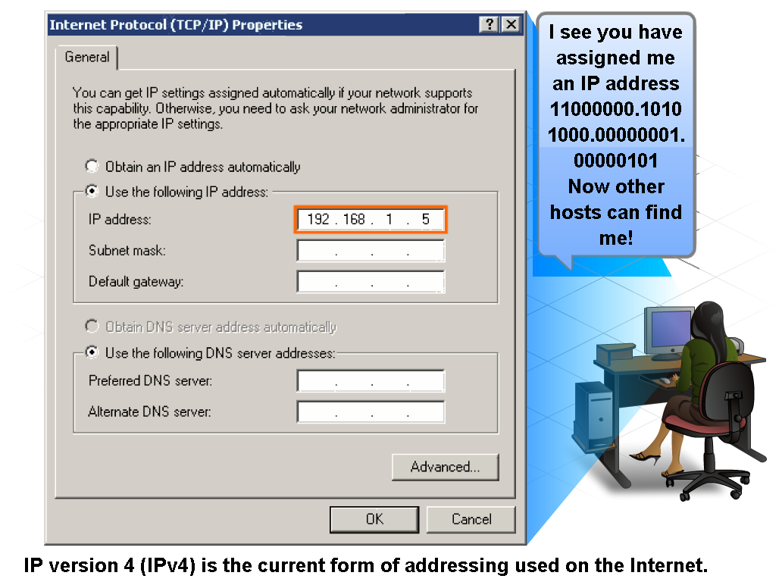
IPv4 Addressing Structure

Slide 6
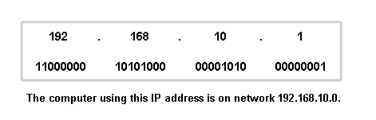
Anatomy of an IPv4 Address
Dotted decimals
Network part
Host part
32 bits
Divided into 4 Octets

Slide 7
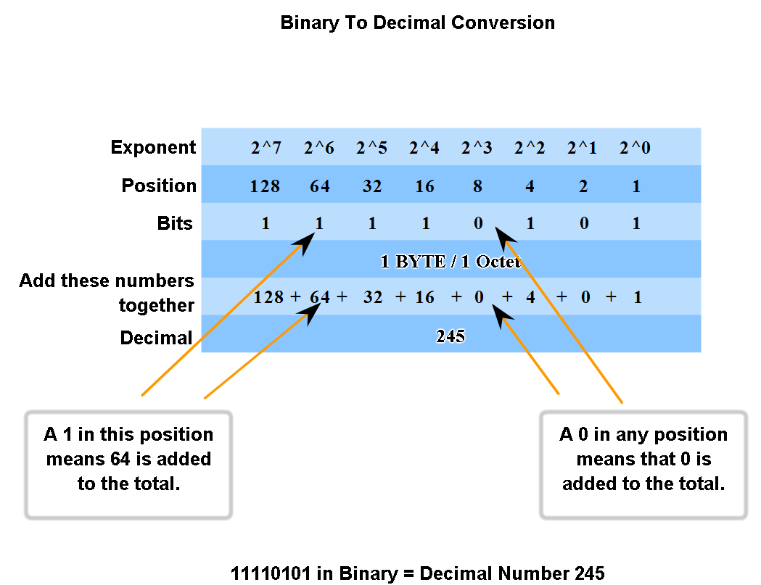
Binary to decimal and Vice Versa

Slide 8
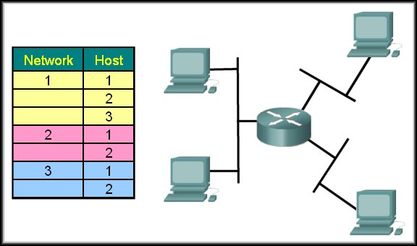
Networks and Hosts
To identify a path or "route" through a network, the address must be composed of two parts:
Network portion
Host portion
1.2
2.2
1.1
2.1
1.3
3.1
3.2

Slide 9
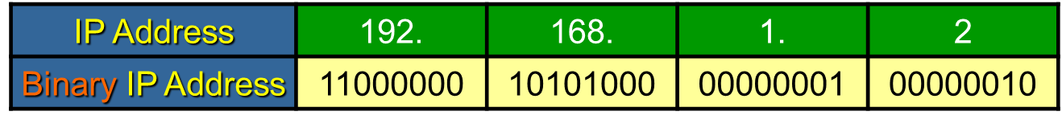
Network Portion
Network Portion:
Some portion of the high-order bits
A network can be defined as a group of hosts that have identical bit patterns in the network address portion of their addresses.
192.168.1.2 | 11000000 | 10101000 | 00000001 | 00000010
192.168.1.67 | 11000000 | 10101000 | 00000001 | 01000011
192.168.1.204 | 11000000 | 10101000 | 00000001 | 11001100

Slide 10
Network Portion
Host Portion:
A variable number of least significant bits that are called the host portion of the address.
The number of bits used in this host portion determines the number of hosts that we can have within the network.
192.168.1.2 | 11000000 | 10101000 | 00000001 | 00000010
192.168.1.67 | 11000000 | 10101000 | 00000001 | 01000011
192.168.1.204 | 11000000 | 10101000 | 00000001 | 11001100

Slide 11
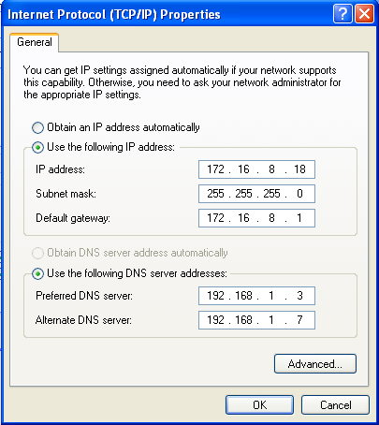
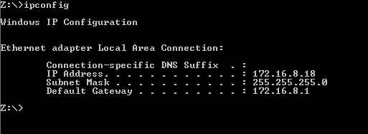
Prefix Mask
How do we or devices identify the network part or the host part?
Answer: Using the “Prefix Mask”.
192.168.10.2/24
Means that the first 24 bits are the network portion.
The last 8 bits are the host portion.
Subnet Mask; the other form of “Prefix Mask”.
Prefix length of /24 means a subnet mask of 255.255.255.0

Slide 12
Subnet Mask
The Prefix Mask and the Subnet Mask are different ways of representing the same information.
Conversion:
Subnet mask has the same format as an IP address. Hence, it has 32 bits divided into 8 bits (octets)
Prefix mask of /24 means, the first (MSB) 24 bits of subnet mask would be 1 and the rest will be 0
Binary: 11111111.11111111.11111111.00000000
Decimal: 255 . 255 . 255 . 0
Examples:
Prefix Mask of /24
Prefix Mask of /16
Prefix Mask of /8
or a subnet mask of 255.255.255.0
or a subnet mask of 255.255.0.0
or a subnet mask of 255.0.0.0

Slide 13
Exercise
What’s the subnet mask of the following?
IP Address: 10.24.36.2 / 4
IP Address: 10.24.36.2 / 12
IP Address: 10.24.36.2 / 16
IP Address: 10.24.36.2 / 23
What’s the prefix mask of the following?
IP Address: 10.24.36.2; Subnet Mask: 255.255.224.0
IP Address: 10.24.36.2; Subnet Mask: 255.255.255.192
IP Address: 10.24.36.2; Subnet Mask: 255.255.255.252
IP Address: 10.24.36.2; Subnet Mask: 255.254.0.0
IP Address: 10.24.36.2; Subnet Mask: 255.255.240.0

Slide 14
ANDing the Binaries
Inside data network devices, digital logic is applied for their interpretation of the addresses.
AND is used in determining the network address.
0 AND 0 = 0
1 AND 0 = 0
1 AND 1 = 1
0 AND 1 = 0
 | Decimal | Binary
IP Address | 135.15.2.1 | 10000111 00001111 00000010 00000001
Subnet Mask | 255.255.0.0 | 11111111 11111111 00000000 00000000
Network Address | 135.15.0.0 | 10000111 00001111 00000000 00000000

Slide 15
But Why AND?
Routers use the ANDing process to determine the route a packet will take.
The network number of the destination IPv4 address is used to find the network in the routing table.
The router then determines the best path for the frame.

Slide 16
IPv4 Addresses
Broadcast Address
Network Address
Host Address

Slide 17
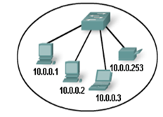
The Addresses
Network Address
All hosts in the network will have the same network bits.
Cannot be assigned to a device.
All host bits in this address will be zero.
10.0.0.0/24
10.0.0.0/24
IP Address | 10. | 0. | 0. | 0
IP Address in Binary | 00001010 | 00000000 | 00000000 | 00000000
Network Part
Host Part

Slide 18
The Addresses
Broadcast Address
Used to send message to all hosts in the network using one single address
Cannot be assigned to a device.
All host bits in this address will be one.
Broadcast Address of 10.0.0.0/24 network is 10.0.0.255/24
10.0.0.255/24
IP Address | 10. | 0. | 0. | 255
IP Address in Binary | 00001010 | 00000000 | 00000000 | 11111111
Network Part
Host Part

Slide 19
The Addresses
Host Address
The unique address assigned to each device on the network.
For a network of 10.0.0.0/24
Addresses 10.0.0.1 through 10.0.0.254 are
All host bits in this address will vary.
Host Address
10.0.0.5/24
IP Address | 10. | 0. | 0. | 1
IP Address in Binary | 00001010 | 00000000 | 00000000 | 00000001
Network Part
Host Part
IP Address | 10. | 0. | 0. | 3
IP Address in Binary | 00001010 | 00000000 | 00000000 | 00000011

Slide 20
The Addresses
Say, you have a random IP address 192.168.10.193/24 or given as 192.168.10.193 255.255.255.0
Say, you have a random IP address 200.32.16.192/26 or given as 200.32.16.192 255.255.255.192

Slide 21
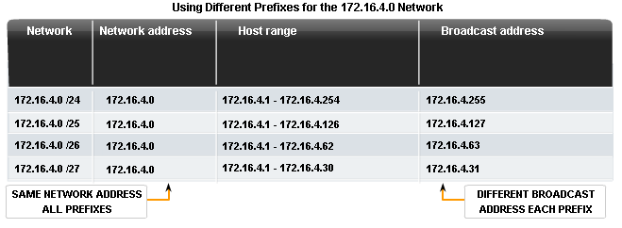
Network Prefix
The network prefix is not always /24.

Slide 22
Types of IPv4 Addresses

Slide 23
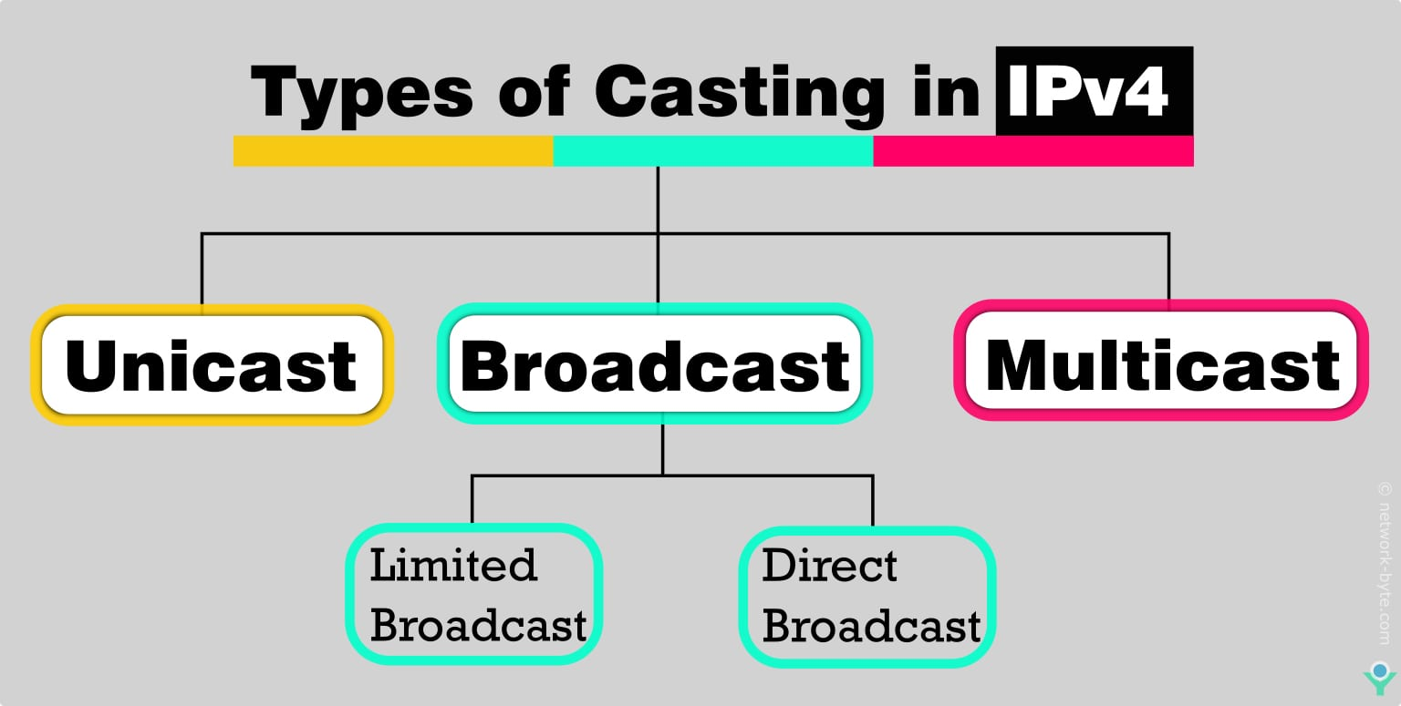
Special Addresses

Slide 24
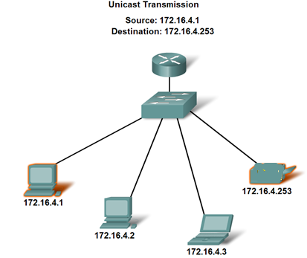
Unicast
Unicast
A message to one host.
Individual IPv4 addresses
Packet
172.16.4.253 | 172.16.4.1 | Data
Dest IP Add | Source IP Add | Packet

Slide 25
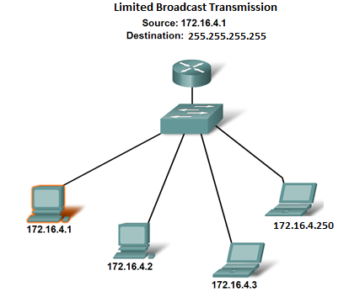
Broadcast
Limited Broadcast
A message to all hosts on the same physical/local network or subnet.
255.255.255.255
Never forwarded by routers!
Packet
Packet
Packet
Packet
Packet
255.255.255.255 | 172.16.4.1 | Data
Dest IP Add | Source IP Add | Packet

Slide 26
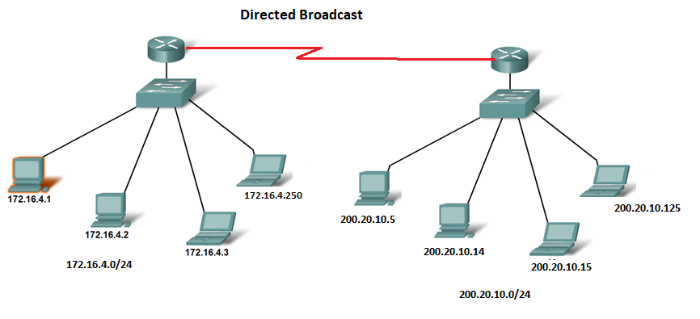
Broadcast
Directed Broadcast
A message to all hosts on a different network or subnet.
broadcast address of a network
Example : 200.20.10.255
Packet
Packet
Packet
Packet
Packet
Packet
Packet
 | 172.16.4.1 | Data
200.20.10.255
Dest IP Add | Source IP Add | Packet

Slide 27
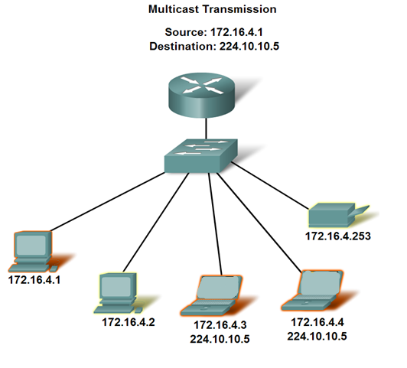
Multicast
Multicast Addresses
A message addressed to a group of hosts.
Uses an IP address starting within this range of 224 - 239
Packet
Packet
Examples of Multicast Application
Video and audio broadcasts
Distribution of software
News feeds
Packet
224.10.10.5 | 172.16.4.1 | Data
Dest IP Add | Source IP Add | Packet

Slide 28
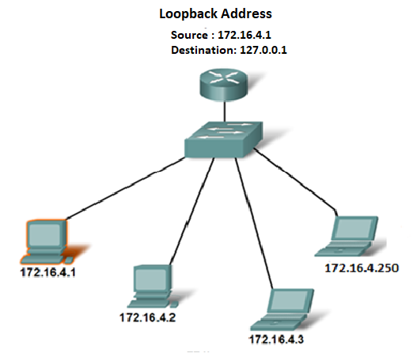
Loopback
Loopback Address
A message addressed to loop back in the device itself.
127.x.x.x of 127.0.0.0/8
Not assigned to any device
Testing and Troubleshooting purpose
Packet
127.0.0.1 | 172.16.4.1 | Data
Dest IP Add | Source IP Add | Packet
Notes:
It allows applications to communicate with each other within the same host without requiring physical network hardware or connectivity.
The loopback address is often used for troubleshooting network issues, testing server applications, or ensuring that network software is functioning as expected locally.
Characteristics: Packets sent to a loopback address never leave the host device; they are routed internally, ensuring no external network traffic is involved.

Slide 29
Anatomy of IPv6 Address

Slide 30

Reasons for using IPv6
Address Availability:
IPv4: 32 bits - 4 octets
2^32 or 4,294,467,295 IP Addresses.
IPv6: 128 bits - 16 octets
2^32
3.4 x 10^38 or
340,282,366,920,938,463,463,374,607,431,768,211,456
(340 undecillion) IP Addresses.
Every grain of sand on every beach on Earth could be assigned over a million unique IPv6 addresses, with plenty to spare (assuming approximately 7.5 x 10^18 grains of sand globally and 2^128 IPv6 addresses).

Slide 31
IPv6 Address
128 bits
given below is a 128 bit IPv6 address represented in binary format and divided into eight 16-bits blocks
Each 4 bits is converted into a Hexadecimal digit
Each block contains 4 Hexadecimal digits
Each block is separated by ‘:’ symbol

Slide 32
IPv6 Address
2
0
0
1
Called string notation

Slide 33
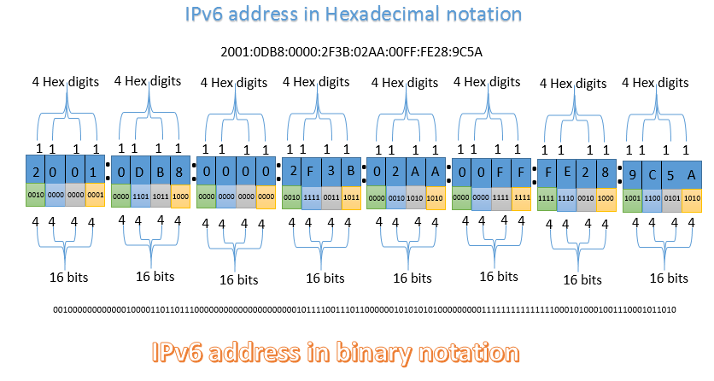
IPv6 Address
Notes:
This is just for the students

Slide 34
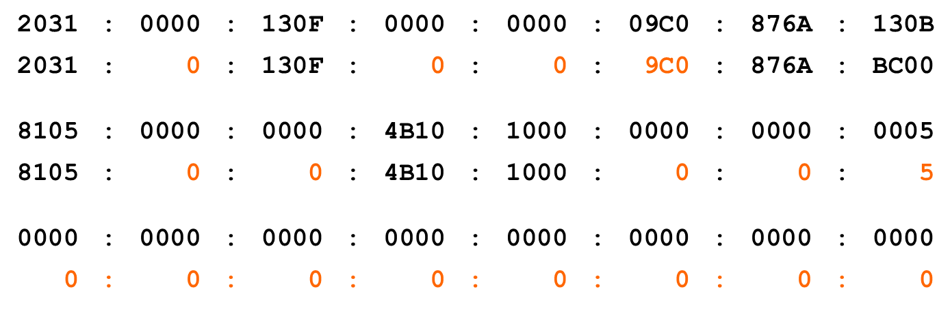
IPv6 Addressing
IPv6 Representation – Rule 1:
The leading zeros in any 16-bit segment do not have to be written. If any 16-bit segment has fewer than four hexadecimal digits, it is assumed that the missing digits are leading zeros.
130B

Slide 35
IPv6 Addressing
IPv6 Representation – Rule 2:
Any single, contiguous string of one or more 16-bit segments consisting of all zeroes can be represented once with a double colon.
1080:0:0:0:8:800:200C:417A | = | 1080::8:800:200C:417A
FF01:0:0:0:0:0:0:101 | = | FF01::101
0:0:0:0:0:0:0:1 | = | ::1
0:0:0:0:0:0:0:0 | = | ::
17

Slide 36
IPv6 Addressing
IPv6 Representation – Rule 2:
Any single, contiguous string of one or more 16-bit segments consisting of all zeroes can be represented once with a double colon.
Example: 1843::22::fa
Illegal because the length of the two all-zero strings is ambiguous.
1843:0000:0000:0000:0022:0000:0000:00fa
1843:0000:0000:0022:0000:0000:0000:00fa
or
18

Slide 37
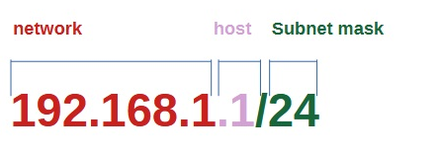

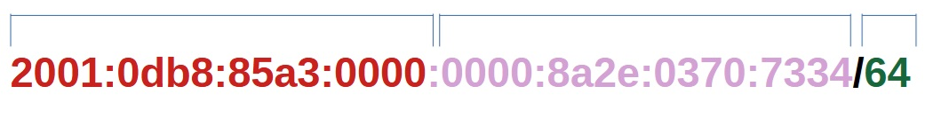
Representing IPv6 addresses
IPv4 Address
IPv6 Address
No Subnet masks in dotted decimal format in IPv6

Slide 38
The End

